Slide 1
Fake Review Classification and Topic Modelling
Presented By:
Vijayalakshmi

Slide 2
Executive Summary
Project overview
The goal of this project is to develop a system that can classify reviews as either fake or real by leveraging a combination of traditional machine learning, deep learning models, and Transformer-based approaches. Additionally, the system will cluster similar reviews together to group related feedback, making it easier to analyze customer insights. Furthermore, it will identify underlying topics within the reviews, providing a deeper understanding of customer sentiments and issues.

Slide 3
Step-by-Step Approach for the Project
Data Collection &Data Set Loading
Data Preprocessing
Topic Modelling (Unsupervised Learning)
Clustering (Unsupervised Learning):
Fake Review Classification (Supervised Learning)
Model Accuracy Report:
Support Vector Machines (SVM): 87.02%
K-Nearest Neighbors (KNN): 65.39%
Decision Tree Model: 74.25%
Random Forest Model: 84.85%
Multinomial Naive Bayes: 84.36%
Logistic Regression: 86.3%

Slide 4
Conclusion & Recommendations
Best Performer: Support Vector Machine (SVM) achieved the highest accuracy, followed closely by Logistic Regression and Random Forest. These models should be considered as the primary candidates for deployment.
Underperforming Models: K-Nearest Neighbors (KNN) performed poorly with only 65.39% accuracy, suggesting that these models are not ideal for this dataset without further tuning or feature engineering.

Slide 5
Deep Learning Models
(applied models like LSTM,BILSTM,BERT)
LSTM (Long Short-Term Memory): LSTM (Long Short-Term Memory) is a specialized type of Recurrent Neural Network (RNN) designed to handle sequential data more effectively than traditional RNNs. While RNNs struggle with learning long-term dependencies due to the vanishing gradient problem, LSTMs were specifically designed to solve this issue by maintaining and updating memory over time.LSTMs can be used to classify text into categories, such as identifying the topic of an article, spam detection, or categorizing reviews.
BiLSTM (Bidirectional LSTM): BiLSTM is an extension of LSTM that processes data in both forward and backward directions (i.e., from past to future and future to past).

Slide 6
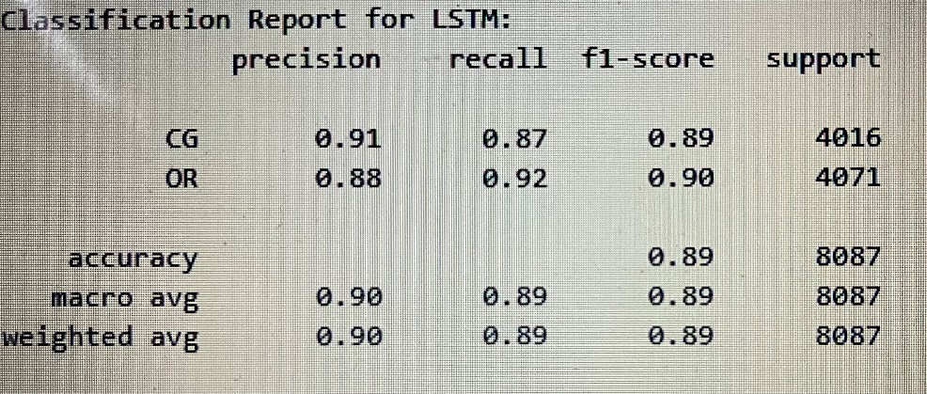
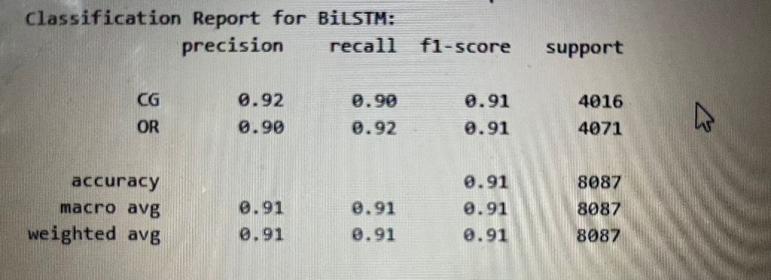
Evaluation metrics for RNN,LSTM,BILSTM
Performance of LSTM
Performance of BILSTM

Slide 7
BERT (Bidirectional Encoder Representations from Transformers) model for sequence classification using the Transformers library by Hugging Face
BERT is a pre-trained transformer-based model developed by Google for Natural Language Processing (NLP) tasks. It uses a transformer architecture, which is fundamentally different from LSTM, and BiLSTM. BERT is designed to understand context from both directions in a text (left-to-right and right-to-left) simultaneously.

Slide 8
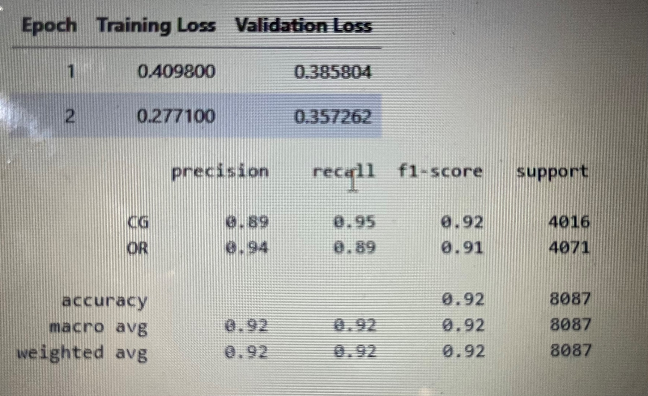
Performance Metrics of Bert model

Slide 9
Summary & Insights
The model achieved excellent performance, with an overall accuracy of 92%.
Precision, Recall, and F1-Score for both classes (CG and OR) are all around 0.92, indicating balanced and strong performance across both classes.
The training loss decreased rapidly, showing that the model is converging well, though the validation loss slightly increased in the last epoch, which could suggest mild overfitting.
This model is performing well on the classification task and generalizes well to unseen data based on the validation results.

